Slide 1

Psychologisches Institut

Slide 2

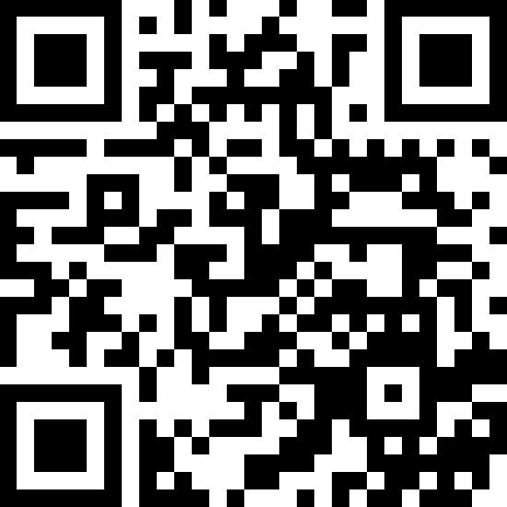
Department of Psychology

